Slide 1
Assignment 3 Web Hacking Challenge Teh Jia Xuan 32844700

Slide 2
Part A Reflected XSS

Slide 3
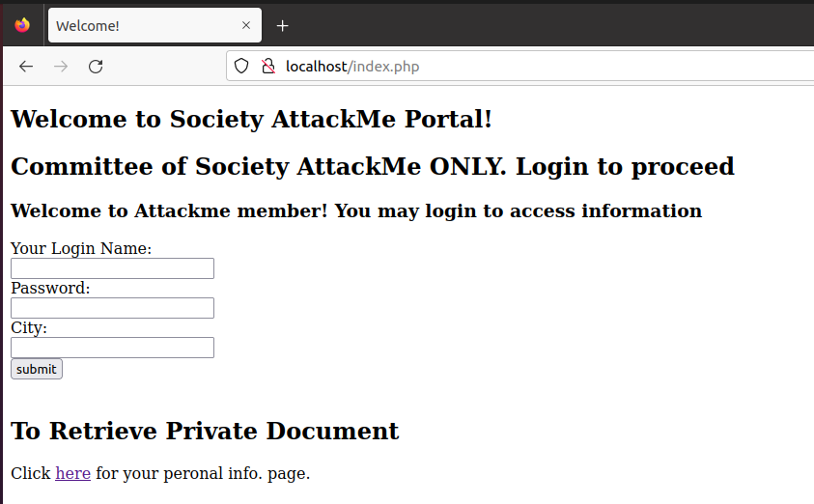
Task A.1 (Home Page Reflected XSS)
1
2
3

Slide 4
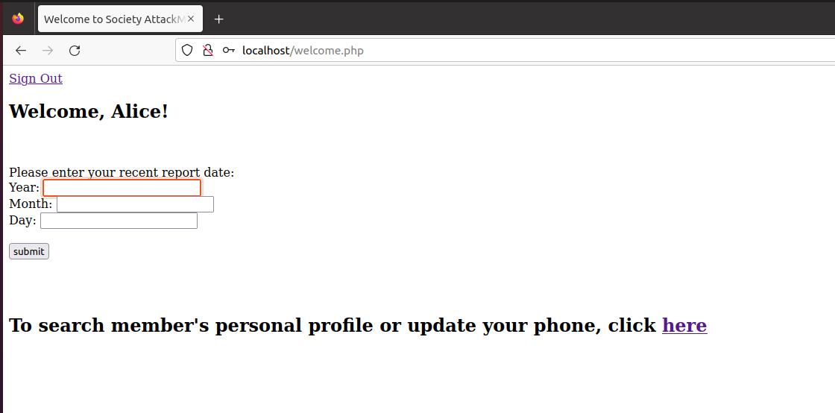
Task A.1 (Greeting Page Reflected XSS)
4
5
6

Slide 5
Reason Potential XSS Vulnerability Points
Input field is not sanitized -> Could inject a malicious script
No validation
Attacker injects script into username value

Slide 6
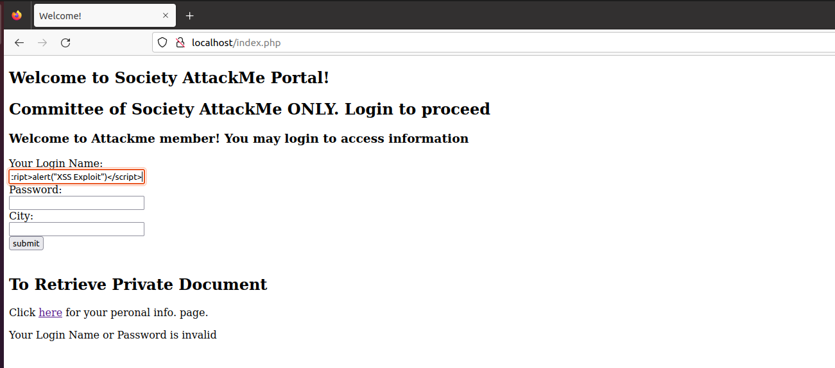
Task A.2 Testing Vulnerability Points
injecting each input with the code ‘<script>alert("XSS Exploit")</script> ’
Example

Slide 7
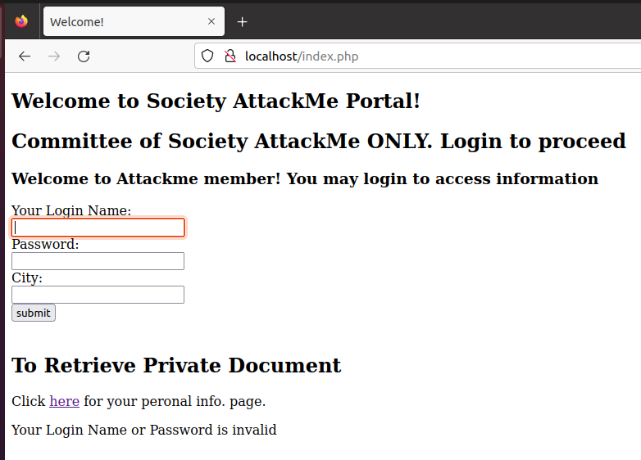
Point 1
Testing
Result

Slide 8
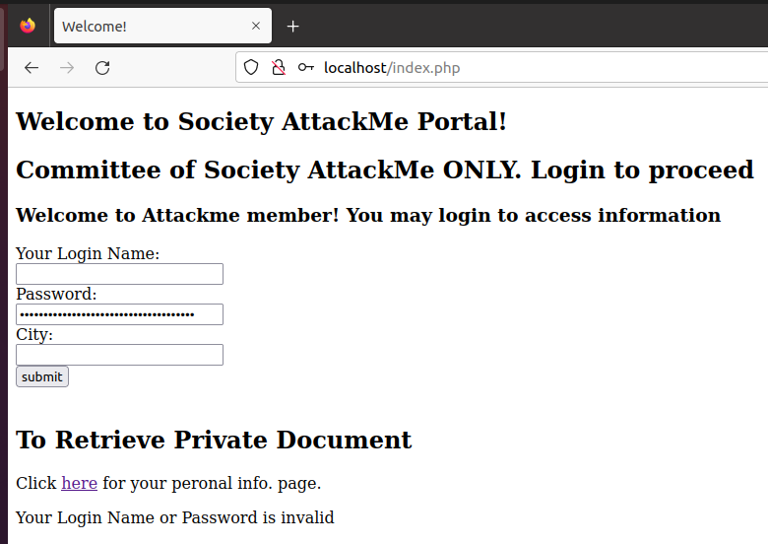
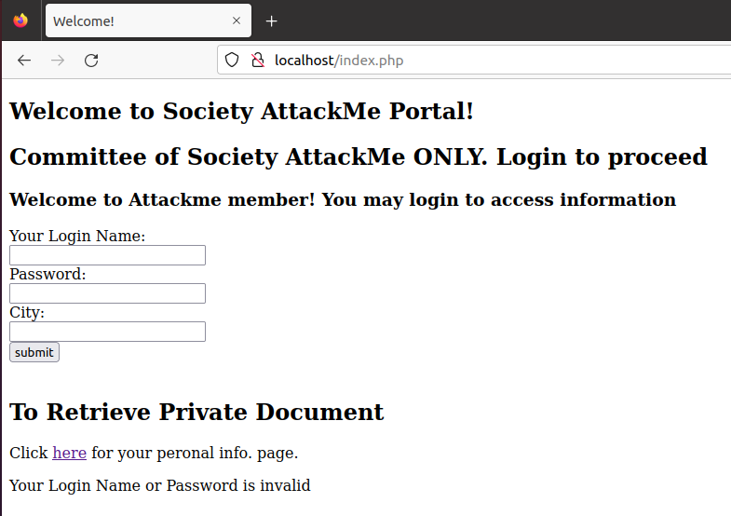
Point 2
Testing
Result

Slide 9
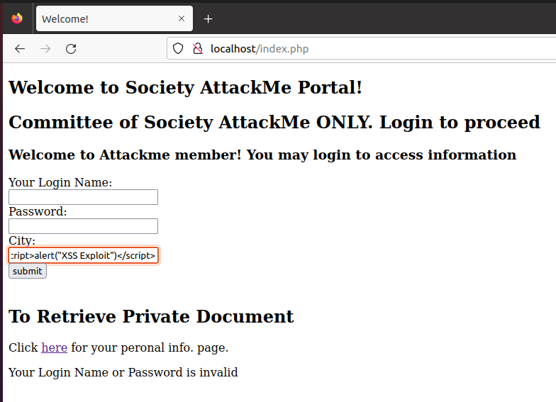
Point 3
Testing
Result

Slide 10
Point 1, 2 & 3
Test Result:
Reflected XSS attack failed
Input is properly sanitised and encoded
Interpretation/Conclusion:
Reflected XSS vulnerability does not exist
Login failed
does not execute the script

Slide 11
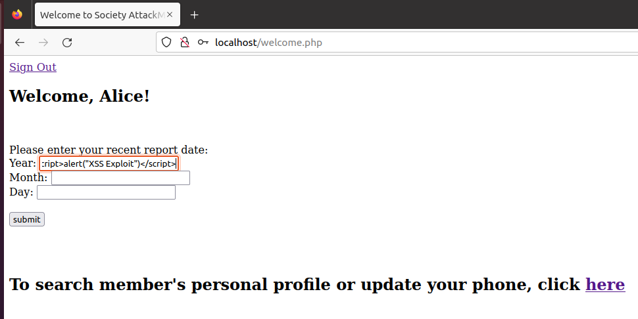
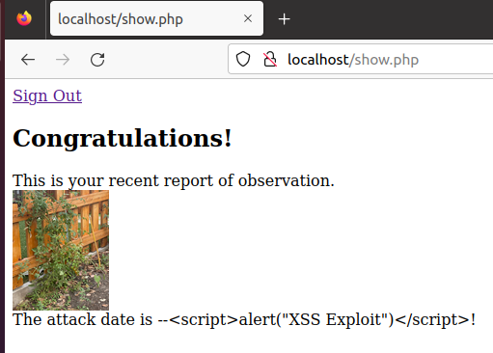
Point 4
Testing
Result

Slide 12
Point 4
Test Result:
Reflected XSS attack failed
Input is properly sanitised and encoded
Interpretation/Conclusion:
Reflected XSS vulnerability does not exist
does not execute the script
Print the injection code on the page

Slide 13
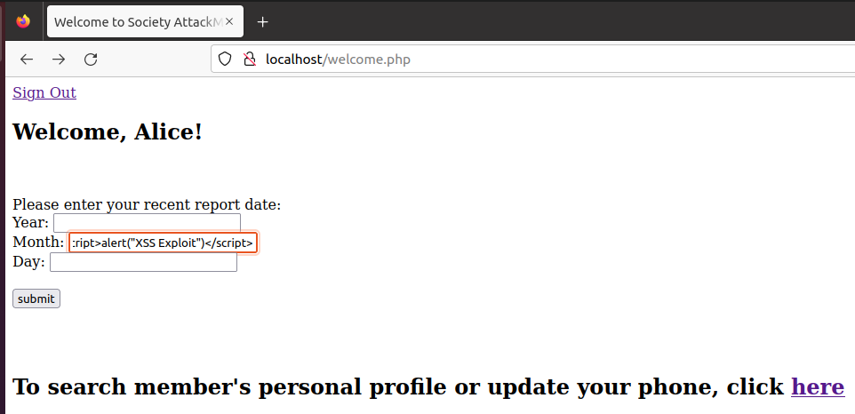
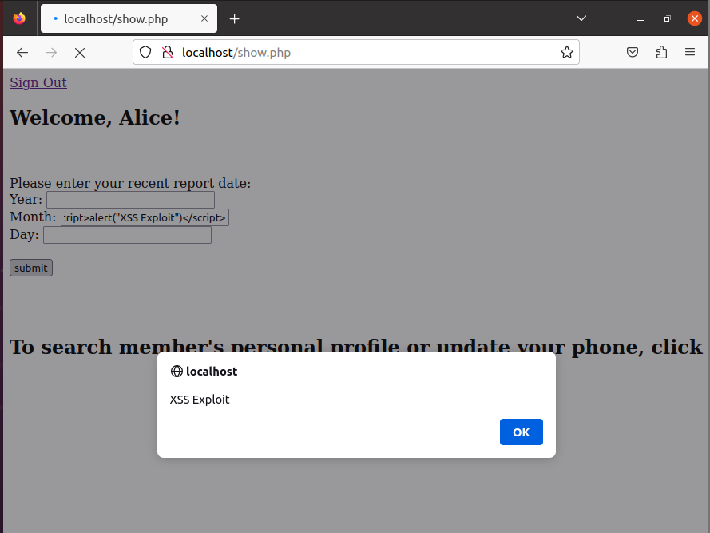
Point 5
Testing
Result

Slide 14
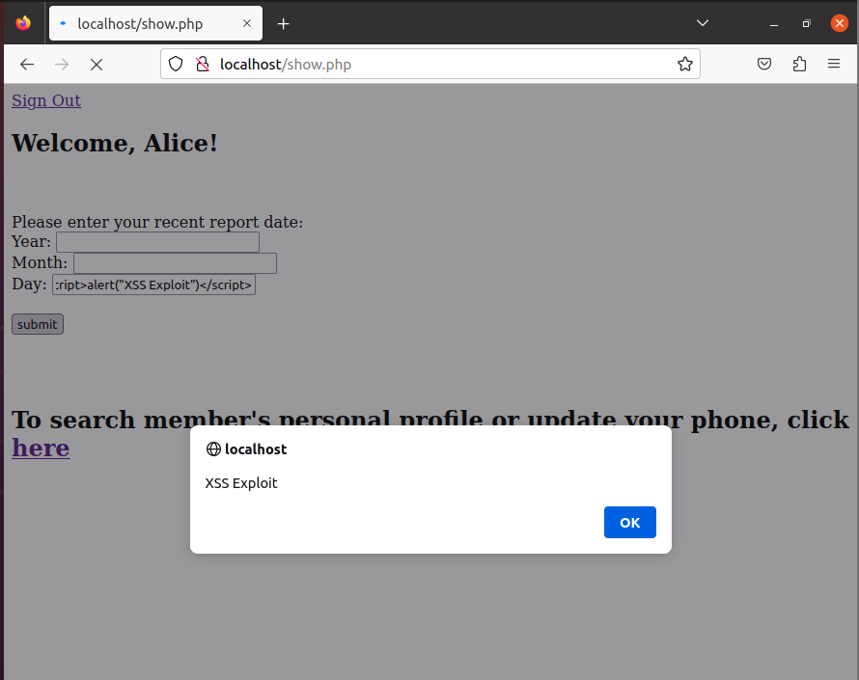
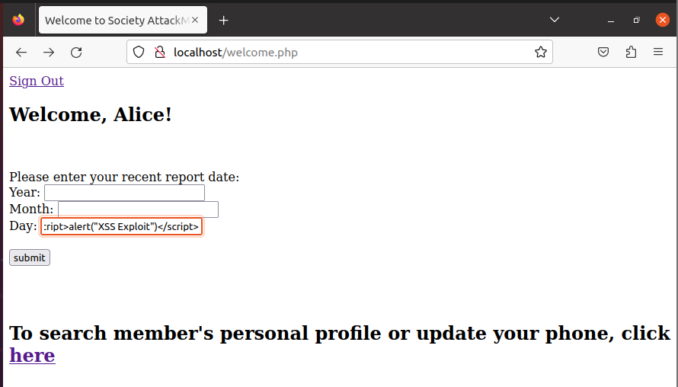
Point 6
Testing
Result

Slide 15
Point 5 & 6
Test Result:
Reflected XSS attack success
Input is not sanitised
Interpretation/Conclusion:
Reflected XSS vulnerability exists in the month and day field
The script is executed

Slide 16
Point 5 & 6(consequences and mitigation)
Consequences
Mitigation
Attacker executes javascript code that extracts user information
Attacker executes script unauthorised access other user
Do malicious activity
Ensure proper sanitization
Ensure proper encoding
Apply special function htmlspecialchars()
to prevent script execution

Slide 17
Part B Unauthorised Access

Slide 18
Part B.1- Unauthorised access Charlie’s data
Vulnerability and how Bob exploits
knowing the system does not validate user’s identity after they log in
Exploiting this vulnerability to unauthorised access Charlie’s private information
After login, request for private document
Change the request memberID to 2
Since the system does not check
Return member ID 2 private document

Slide 19
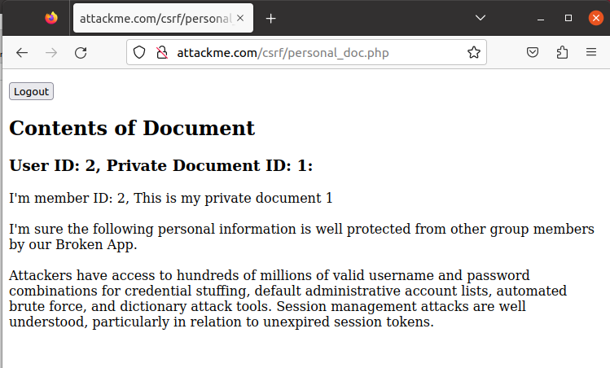
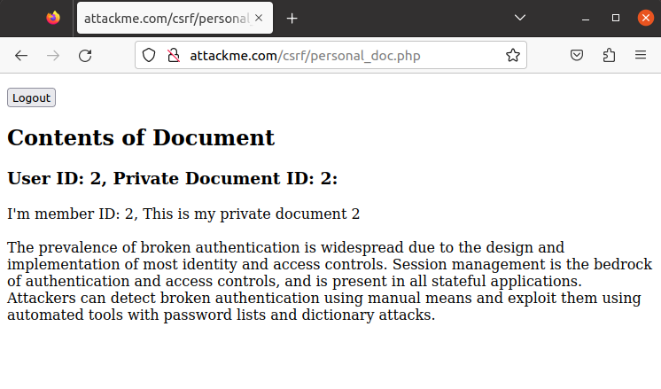
Part B.1 Private data of Charlie
Charlie’s Doc 1
Charlie’s Doc 2

Slide 20
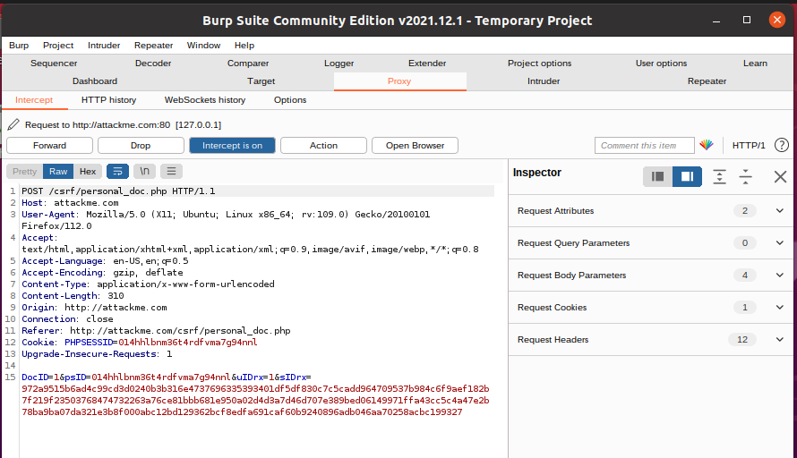
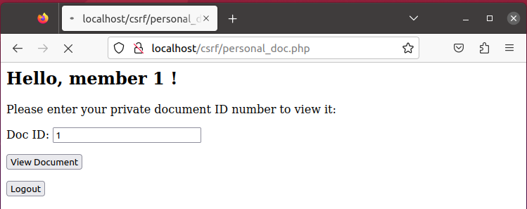
Part B.1 Demonstrate (Private Document 1)
Intercept request when requesting Doc

Slide 21
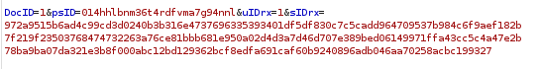
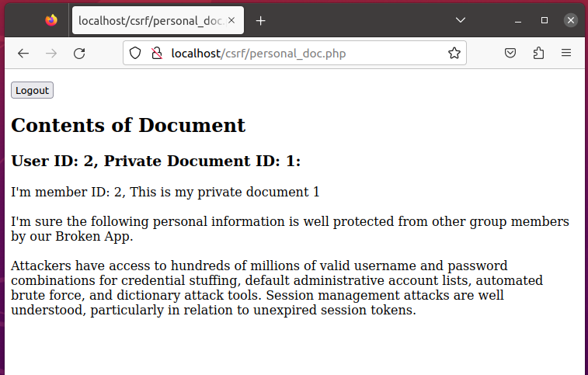
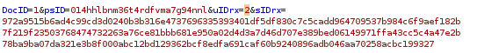
Part B.1 Demonstrate (Private Document 1)
Modify uIDrx to 2, Switch to Charlie’s ID
Charlie’s Doc 1

Slide 22
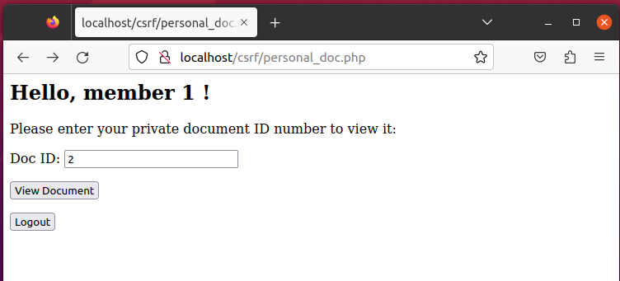
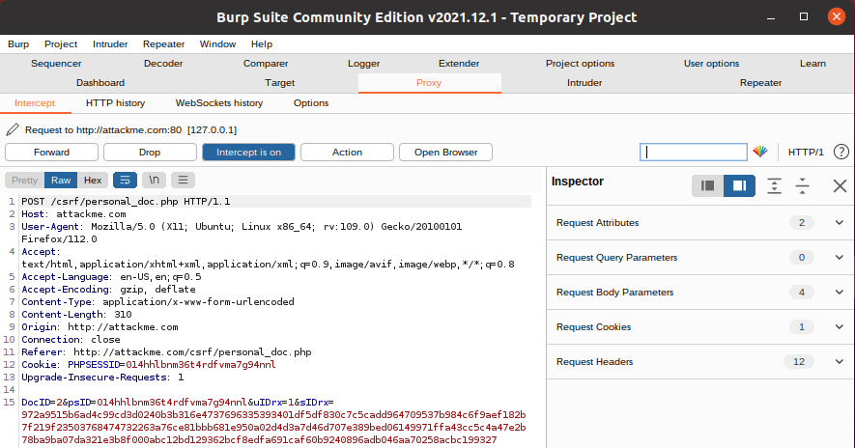
Part B.1 Demonstrate (Private Document 2)
Intercept request when requesting Doc

Slide 23
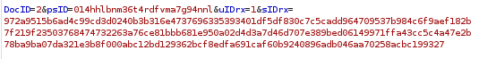
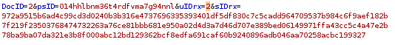
Part B.1 Demonstrate (Private Document 2)
Modify uIDrx to 2, Switch to Charlie’s ID
Charlie’s Doc 2

Slide 24
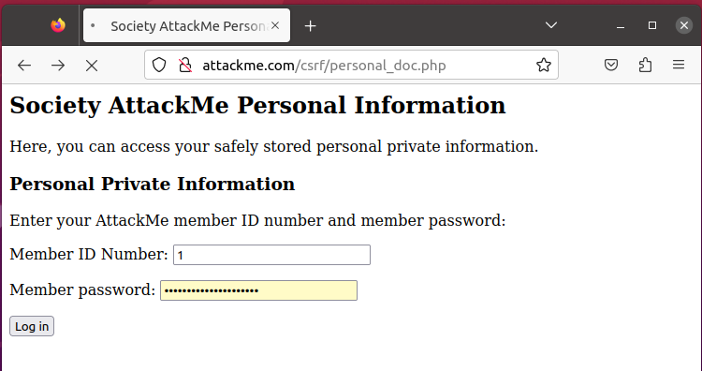
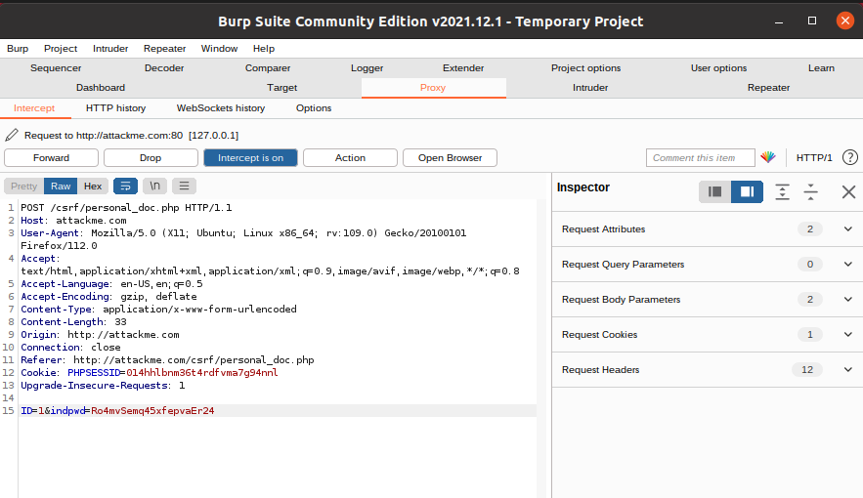
Part B.1 tests attempt 1
Intercept request when login

Slide 25
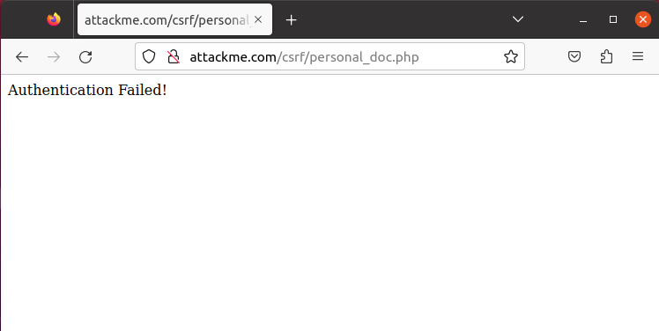
Part B.1 tests attempt 1
Switch ID to Charlie’s
Authentication Failed

Slide 26
Part B.1 tests attempt 1 interpretation
Authentication failed
Changing ID in burpsuite -> the password is ID 1’s password
Same as entered ID 2 but entered incorrect password
System does not recognize the password for ID 2

Slide 27
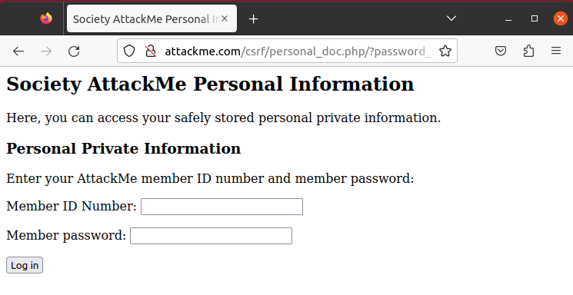
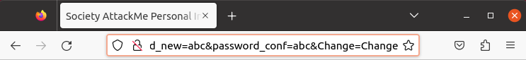
Part B.1 tests attempt 2
Force change Charlie’s password
http://attackme.com/csrf/personal_doc.php/?password_new=abc&password_conf=abc&Change=Change
Paste URL

Slide 28
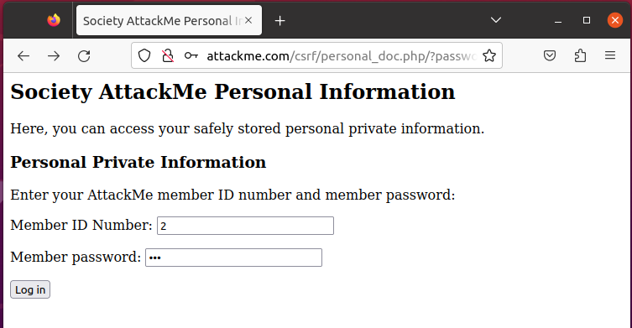
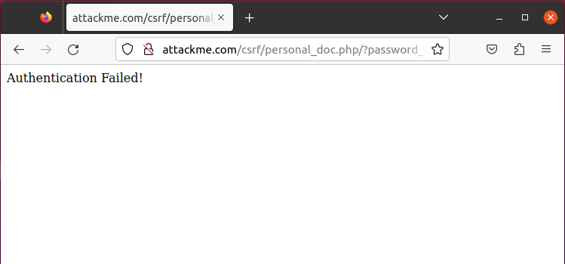
Part B.1 tests attempt 2
Login with Charlie’s new password
Authentication Failed

Slide 29
Part B.1 tests attempt 2 interpretation
Authentication Failed
The page does not change password of member ID 2
Incorrect password for member ID 2
The page check for password

Slide 30
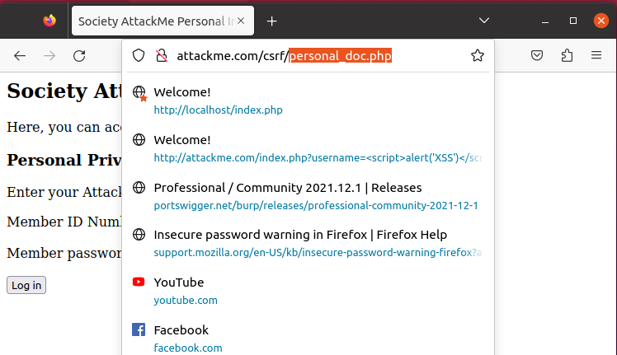
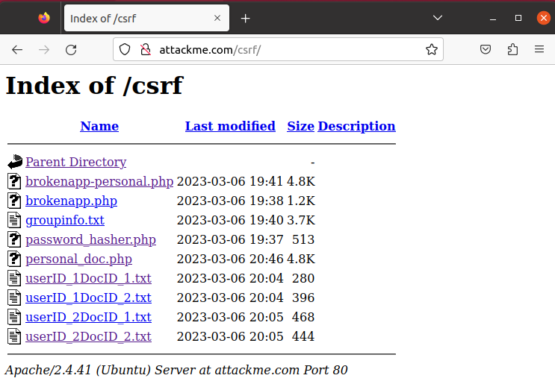
Part B.1 tests attempt 3
Modifying URL to access backend
Have access to all backend files

Slide 31
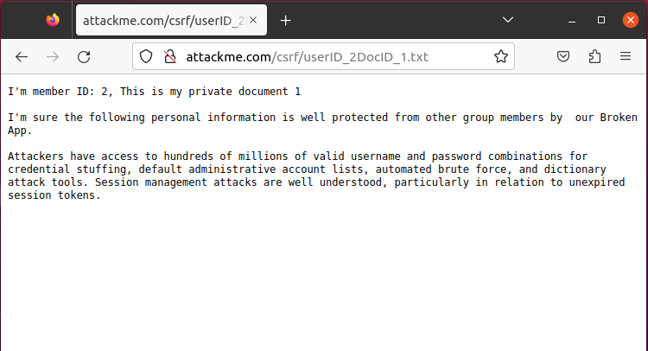
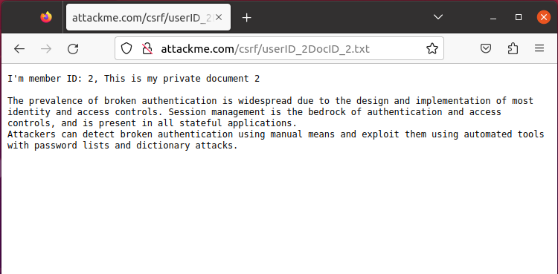
Part B.1 tests attempt 3
Able to view other’s file

Slide 32
Part B.1 tests attempt 3 interpretation
Able direct access backend files
Does not sanitized URL
Access to all the private documents of other users

Slide 33
Part C SQL Injection

Slide 34
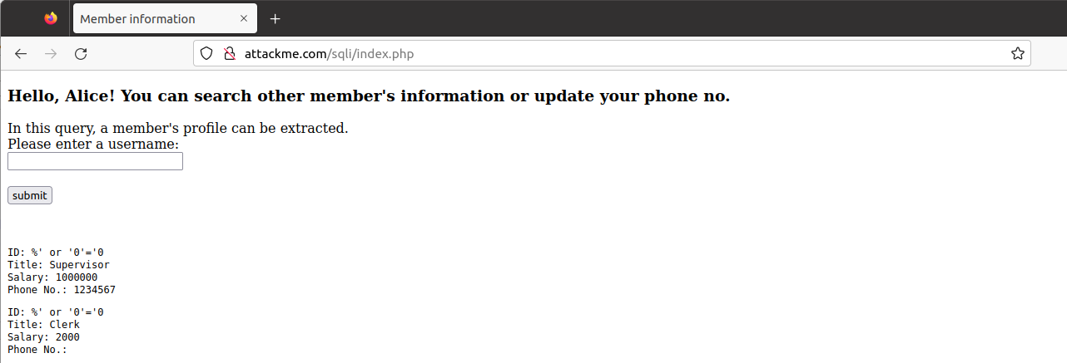
Part C.1
(a) List all the users in database
SQL injection Statement
%' or '0'='0 in the field
User information
Notes:
The % will be compared as the user ID which will be very unlikely to match any as the IDs are numbers. The single quote will mark the end of the ID condition. An additional condition is provided with or which is followed by a condition that is always true. This will produce the list of all users in the database. The last single quote is omitted as a quote will be added by the script after the entered text.

Slide 35
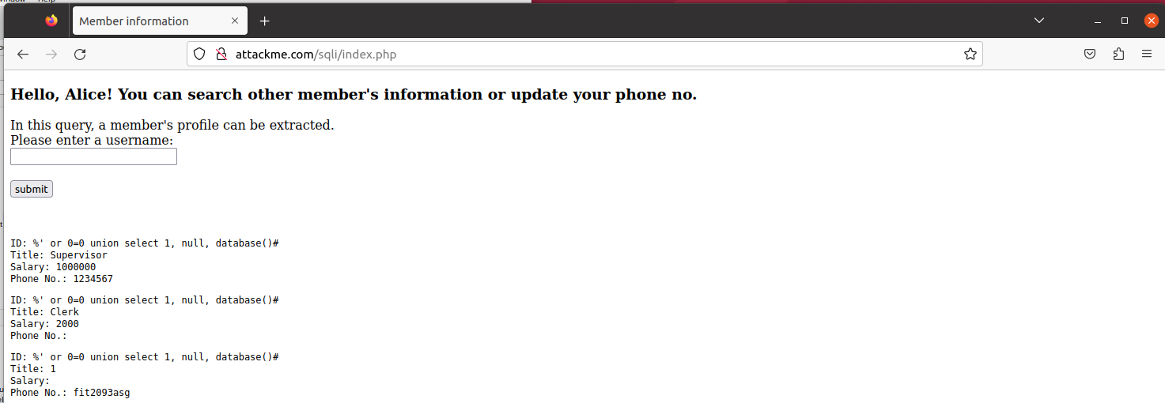
Part C.1
(b) Determine name of database
SQL injection Statement
%' or 0=0 union select 1, null, database()#
fit2093asg

Slide 36
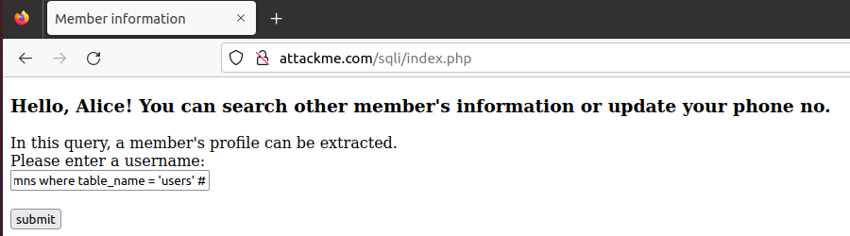
Part C.1
(b) Determine all the fields in the table
SQL injection Statement
%' and 1=0 union select 1,null, concat(table_name,0x0a,column_name) from information_schema.columns where table_name = 'users' #

Slide 37
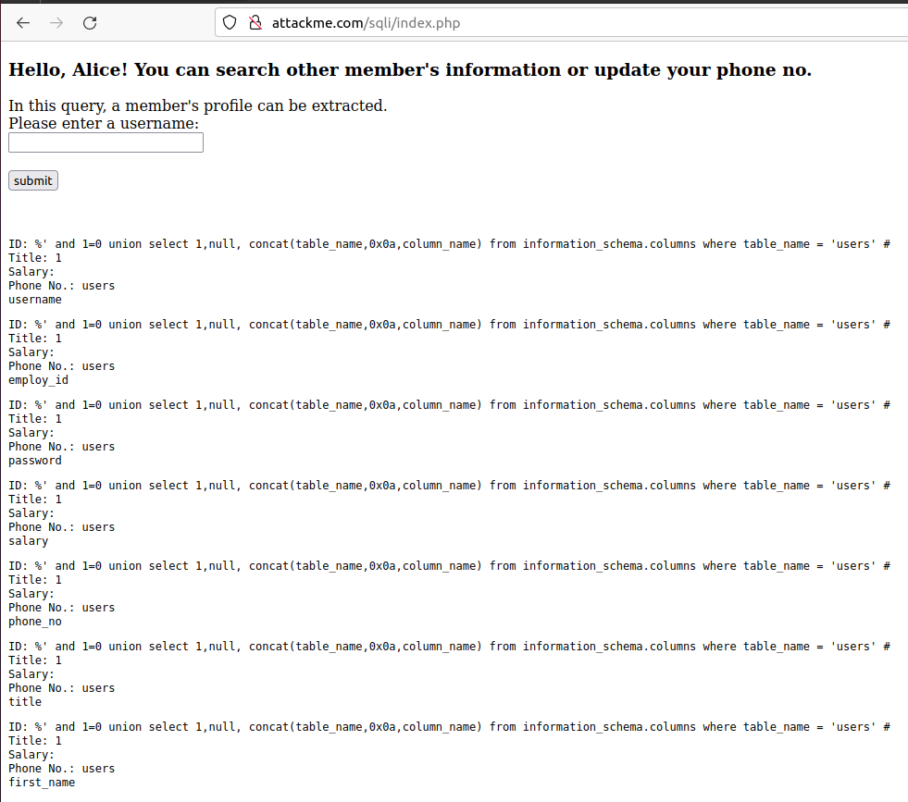

Slide 38
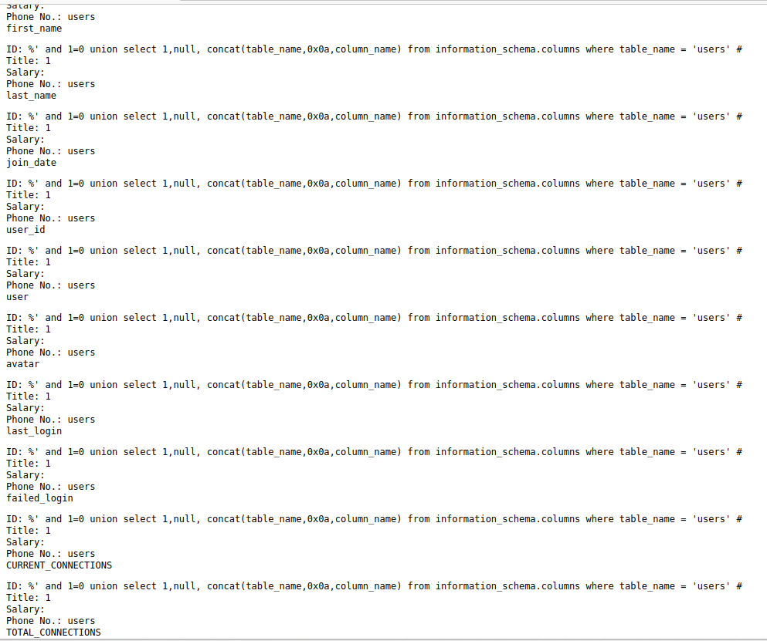

Slide 39
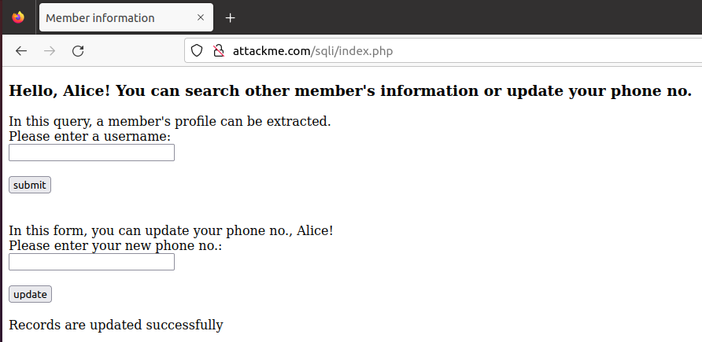
Part C.2
(a) Update other information other than phone no.
SQL injection Statement
1111111' , salary = '1

Slide 40
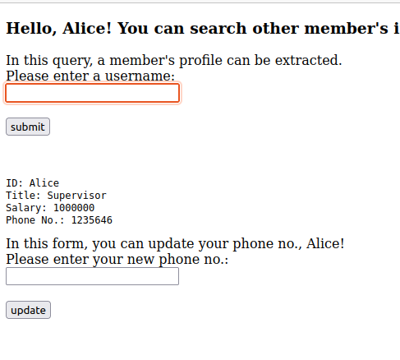
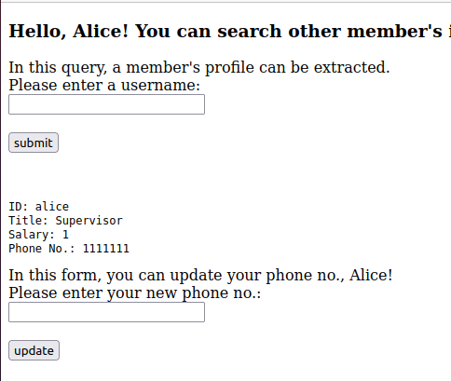
Part C.2
(b) Update other information other than phone no.
SQL injection statement: 1111111' , salary = ‘1
Before After

Slide 41
Part C.2
b) Interpretation of tests results
The system lack of security controls
Unable to detect SQL injection
Insufficient input validation
User could gain administrative privileges

Slide 42
Part D Privacy & Ethical

Slide 43
Part D: Privacy and Ethics
(a) Privacy
Task A, attacker inserts a script to capture user information, leak of information
Task B, attacker changes user ID to read others’ private document, confidentiality compromised
Task C, attacker does SQL injection to obtain one’s sensitive information
manipulate other information to benefit himself
Notes:
Task A eg credit card info

Slide 44
Part D: Privacy and Ethics
(b) Ethics issues
Task A, reflected XSS led to compromises in confidential information, inject malicious script
Task B, unauthorised access led to privacy breaches, malicious activities
Task C, SQL injection led to data manipulation, identity theft, privacy breaches, reputation damage

Slide 45
Thanks!
Any questions?
jteh0015@student.monash.edu
+60189111896
Please follow my Instagram
@tehjiaxuan

